Slide 1
Good evening
Developers

Slide 2
We are Team CKT
And our topic is “Global Warming”

Slide 3
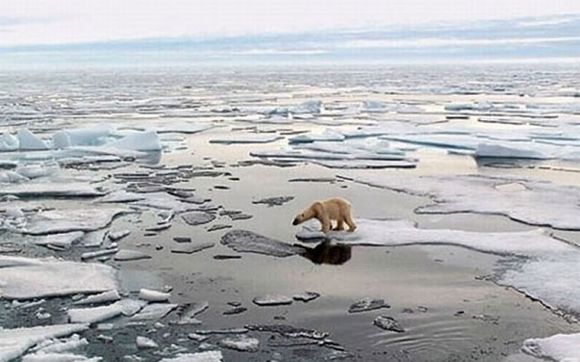
A Quick Look at the Imminent Problem
What is Global Warming ?

Slide 4
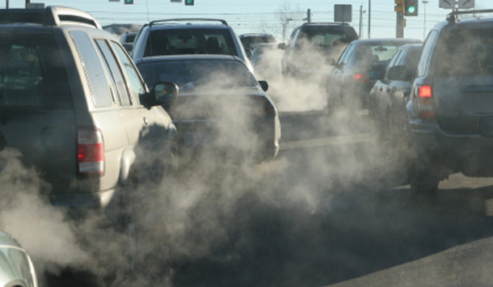
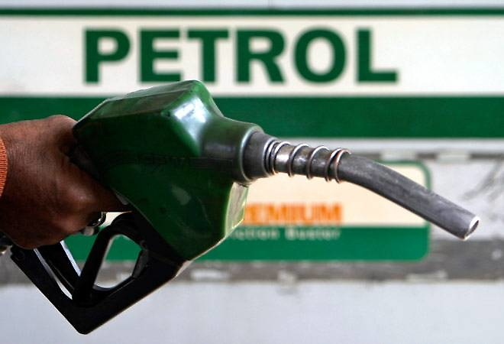
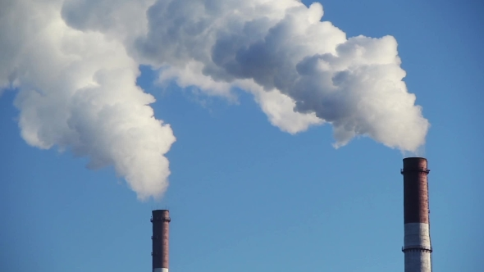
“Our actions have consequences”

Slide 5



What can you do about it ?
A very simple Idea
A Revolutionary Environment App
Orbis

Slide 6

One App to Help Earth
Get Insights into Environment Conservation
Tips and Stories about Environment
Facts, Truths & Myths about Global Warming
Instant Carbon Footprint Calculator
News from Around the Globe
Environment friendly practices that you can adopt

Slide 7
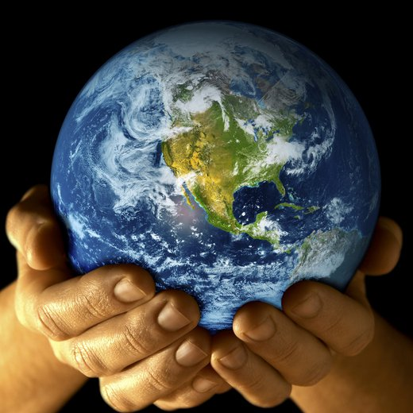
Learn from the leaders in Environment Conservation
Read about the
success stories
of the most Influential
Environmentalists
to ever walk
This Green Earth
Get Tips on Conservation

Slide 8
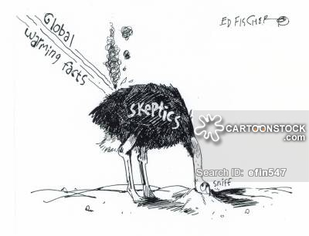
Bust ‘em myths, get informed
Convince the skeptics
with the Science
behind the Environment
Know the facts

Slide 9
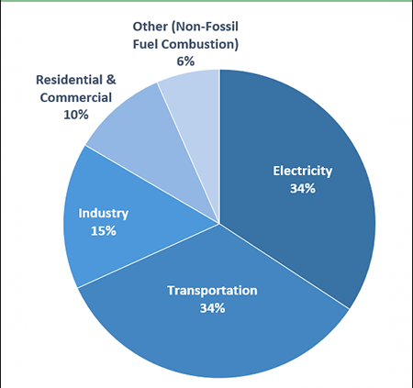
Know your Carbon Footprint
And how you can reduce it !
No, it isn’t your shoe size
Carbon Footprint is the amount
of carbon dioxide released
into the atmosphere as a
result of your day to day activities

Slide 10

Get the latest News Feed
Happenings from around the world on issues cover Earth and Climate
Cards of latest News

Slide 11


Made with
Flutter SDK

Slide 12
That’s all folks !
Save your Environment
Download OrBis
Mr Start is busy

